Slide 1


Slide 2

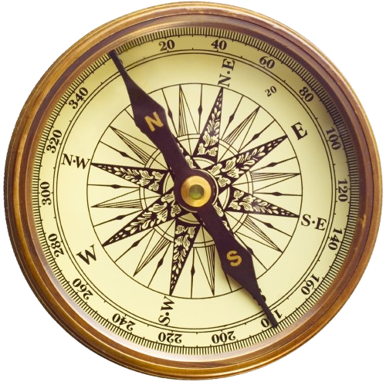
Columbus
Your pocket guide to everywhere.

Slide 3
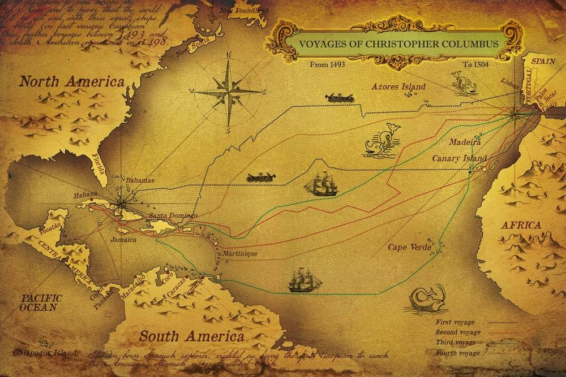
INTRODUCTION TO CHALLENGES OF TOURIST:
Tourists face a range of challenges that can impact their travel experiences, often transforming a dream trip into a stressful ordeal. One of the primary difficulties is navigating unfamiliar environments, from language barriers to cultural differences, which can create confusion or discomfort. Safety concerns, whether related to health, crime, or political instability, also weigh heavily on travelers’ minds, affecting their ability to enjoy new destinations.

Slide 4
Problem Statement :
1.Searching of Hotels :
Overwhelming Choices – The vast number of hotel options can make it difficult to decide where to stay.
Price Fluctuations – Hotel prices often change due to demand, seasonality, and booking timing, making it hard to lock in the best deal.
Hidden Fees – Unexpected charges like resort fees, taxes, or parking costs can inflate the total cost of a hotel stay.
Location Confusion – Difficulty in understanding how far a hotel is from major attractions or public transport, leading to poor location choices.
Fake or Biased Reviews – Sorting through fake or biased reviews can make it challenging to get an honest sense of the hotel's quality.
Inaccurate Descriptions or Photos – Misleading descriptions or outdated photos can result in unmet expectations upon arrival.

Slide 5
2. Searching of Restaurants :
Language Barriers – Difficulty understanding menus, restaurant websites, or
reviews due to language differences.
Overwhelming Choices – Too many restaurant options, making it hard to decide where to eat, especially in large cities.
Inaccurate Reviews – Fake or inconsistent reviews can mislead tourists about the quality and service of restaurants.
Dietary Restrictions – Finding restaurants that accommodate specific dietary needs (e.g., vegetarian, vegan, halal, gluten-free) can be challenging.
Lack of Local Knowledge – Not knowing where locals eat can result in tourists choosing overpriced or tourist-trap restaurants.

Slide 6
3. Places to visit :
Lack of Information – Difficulty finding reliable information about lesser-known attractions, opening hours, or entrance fees.
Distance and Accessibility – Challenges in reaching remote or less accessible destinations due to lack of transportation options.
Seasonal Limitations – Certain places may be closed or less enjoyable during off-seasons due to weather or maintenance.
Cultural or Language Barriers – Difficulty in understanding signs, guides, or local customs, which may limit the experience.
Tourist Traps – Falling into over-commercialized, overpriced, or inauthentic locations that cater mainly to tourists.

Slide 8
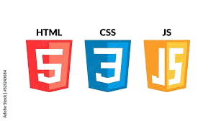





Technology Used :

Slide 9
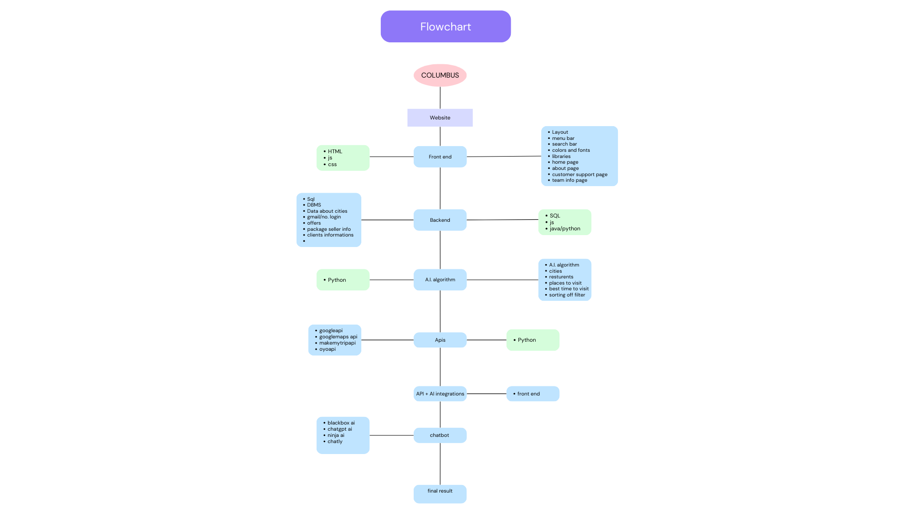
FLOWCHART :

Slide 10
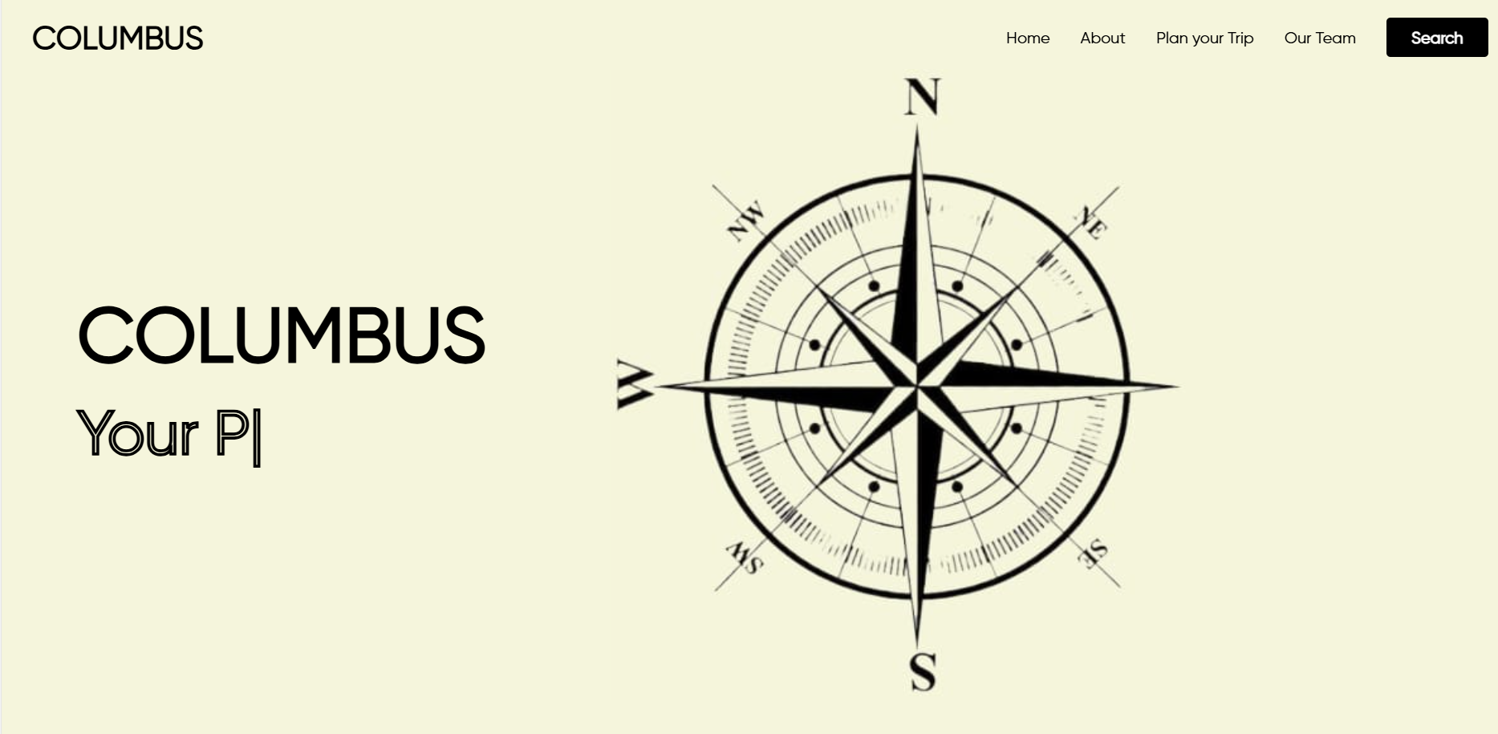
Prototype :

Slide 11
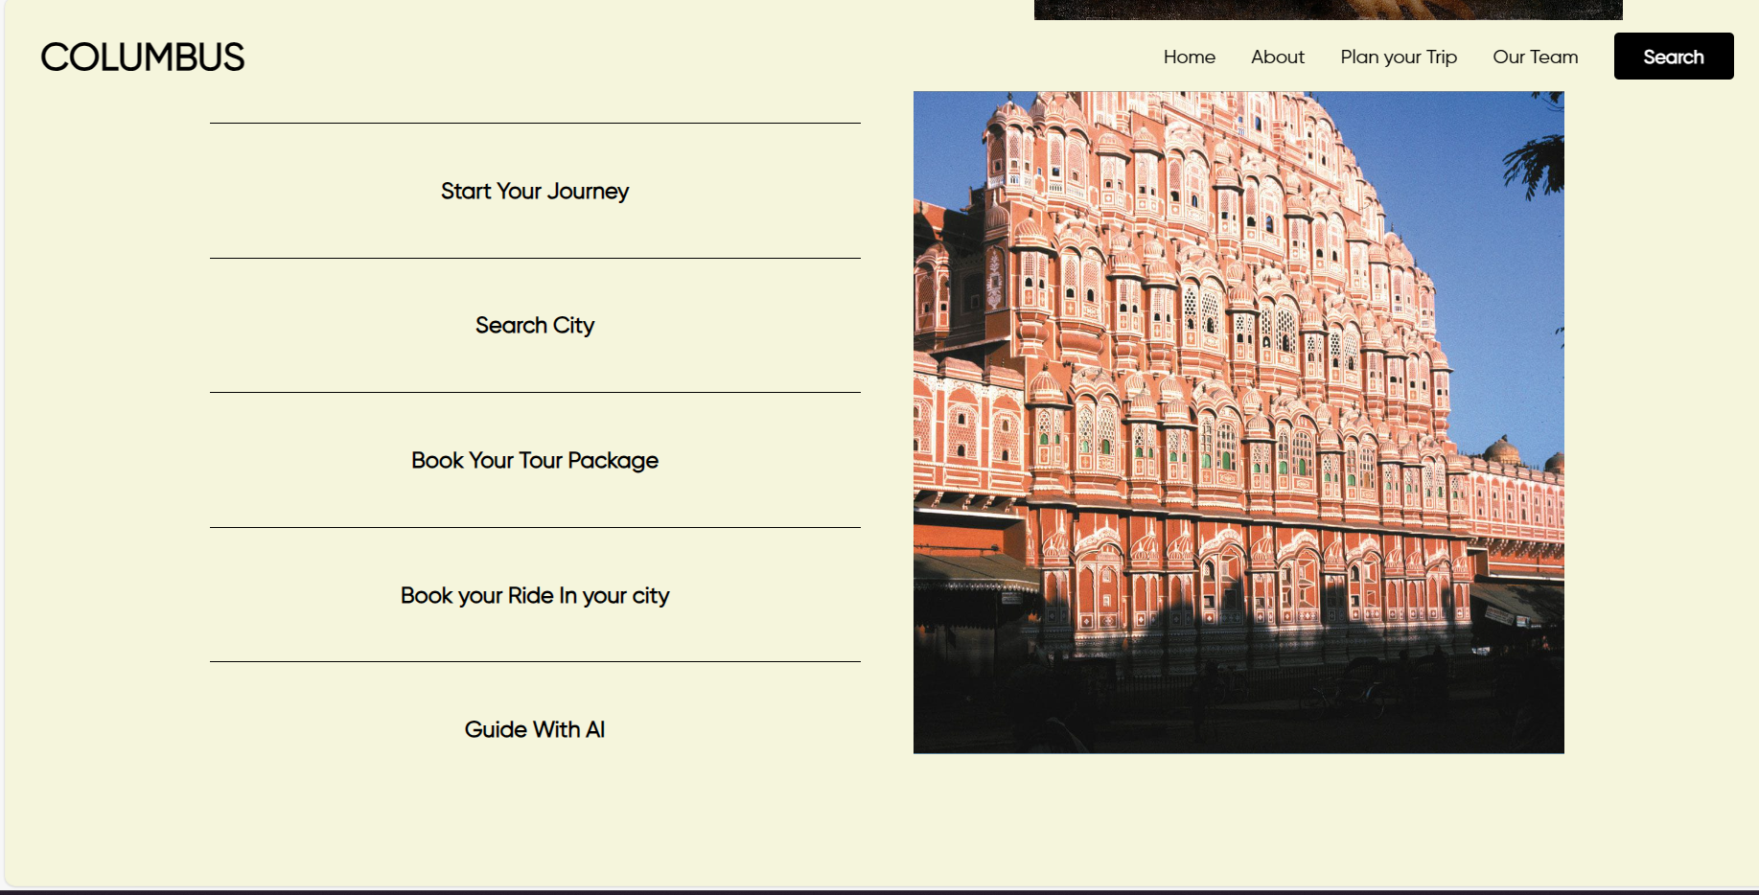

Slide 12
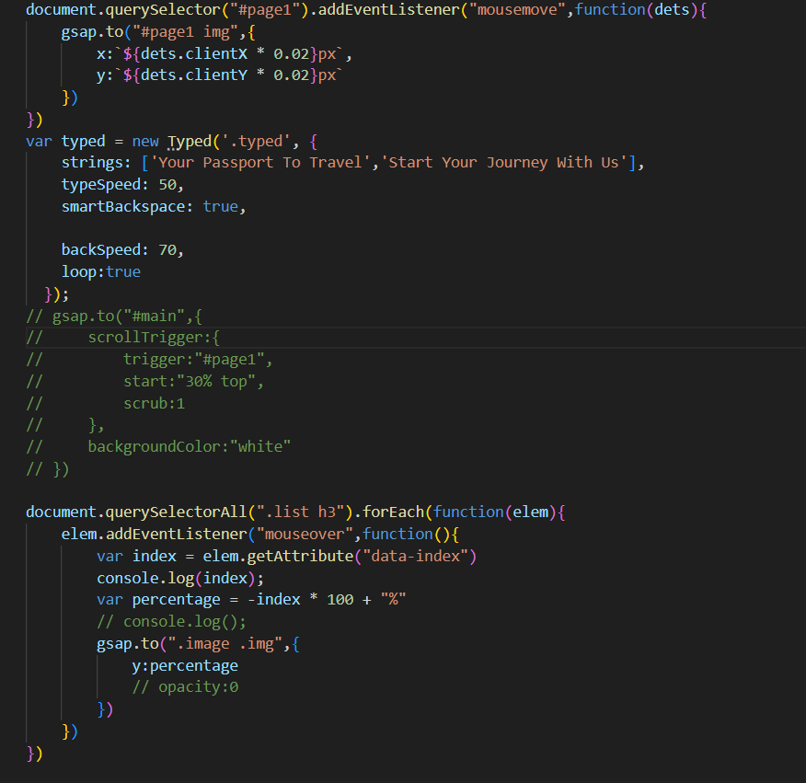
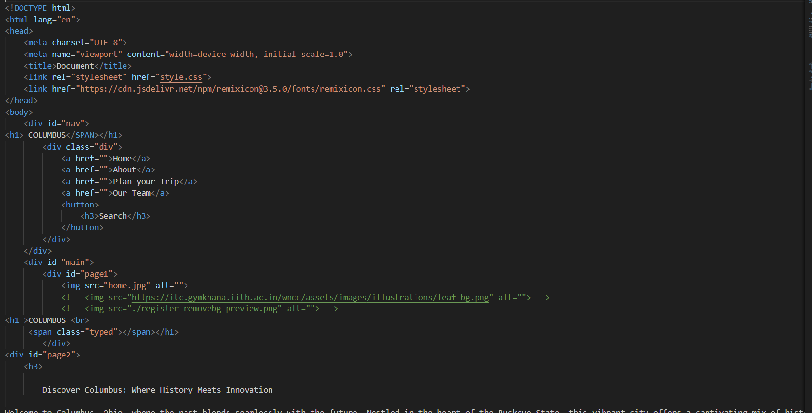
Code :

Slide 13
Columbus
Your pocket guide to everywhere.
Team Members :
Shriyansh Dixit (0103AD221202)
Vishakha Patel (0103AD221)
Nikunj Balothiya(0103AD221)

